Slide 1
Addressing Drug Safety Challenges for Small & Emerging Biopharma
Notes:
Moderator script for webinar, Addressing Drug Safety Challenges for Small & Emerging Biopharma
November 3, 2021 • 1:00 pm EDT
Hello everyone and thank you all for joining us today for our webinar titled, “Addressing Drug Safety Challenges for Small & Emerging Biopharma”. My name is Steven Beales and I am the SVP of our Scientific and Regulatory group at WCG. I’ll be joined by my colleague Angela Pitwood. We’re glad to have you all here today!
Now, let’s get started. We’re going to hear from Angela and myself, and then we’ll move on to answering some of your questions. If you would like to ask a question, click on the Q&A icon located at the bottom of your screen to open the question panel. Type your question and click Send. If we run out of time to answer your question during today’s session, we will follow-up with you immediately afterwards.

Slide 2
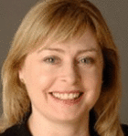
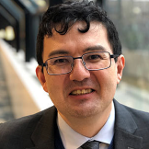
Meet Today’s Speakers
Angela Pitwood
Vice President, Pharmacovigilance, Scientific and Regulatory Review, WCG
Steven Beales
Vice President, Scientific and Regulatory Review, WCG

Slide 3
Today’s Drug Safety Challenges for Small and Emerging Biopharma
Problem statement for drug safety operations at small and emerging biopharma
Small & Emerging Biopharma are challenged to find a flexible, scalable drug safety partner models that allow development pipelines to have dedicated teams looking at each new drug safety signal/SAE within the same small group of people, provide high quality case processing, and have the expertise to conduct global safety operations.
Why? It’s very costly to build this function entirely in-house and most outsourced drug safety options are built for medium to large scale/volume safety work.
This means where the bulk of early development work now occurs for small and emerging biopharma, it is difficult to build a small, efficient drug safety operation or external partnership.
Notes:
Here’s the problem statement we’re all gathered here today to help solve –
Small & Emerging Biopharma have challenges to finding flexible, scalable drug safety partners
It’s more vital for lean to fins
Byulk work complex safety profile
It’s

Slide 4
Poll #1
Which of the following challenges in drug safety are you currently facing?
Lack of case processing quality
Hidden or spiraling costs
1
5
Lack of attention from your current provider
N/A
2
6
Lack of pharmacovigilance expertise
3
Dealing with multiple CROs to handle current
safety operations
4
Notes:
We are going to start our presentation today with 2 polling questions so that we can focus our content on the needs of this audience.
Let’s pull up the first poll now. Of the following, which challenges are you currently facing? Please select all that apply.

Slide 5
Poll #2
How are you currently handling your drug safety operations?
Fully in-house operations
Specialty pharmacovigilance provider
1
4
A single CRO on both clinical and safety
operations
Mix of the above
2
5
Multiple CROs
Other
3
6
Notes:
Now onto the second poll question, “How are you currently doing your drug safety activities?”
And now I’d like to give a warm introduction to our speaker first speaker today, Ms. Angela Pitwood, Vice President, Pharmacovigilance, at WCG. Angela is a drug safety expert with over 25 years’ experience at CROs and as VP of Pharmacovigilance at Pfizer, where she was responsible for Pfizer’s global drug safety operations. Angela co-founded our drug safety division 7 years ago dedicated specifically to bringing the knowledge and expertise of professionals such as herself to the needs of small and emerging biopharma, who she realized were not getting the attention they deserve from larger companies.

Slide 6
WCG’s Global Safety Reporting Regulatory Intelligence “Reference Model”
Notes:
Thank you, Angela, I’m Steven Beales and I am an expert in safety reporting with over 20 years in pharma industry with the last 12 years focused on global safety reporting. I co-developed the global safety reporting systems for Roche, Janssen, Labcorp, Celgene and Amgen as well as dozens of small and emerging biopharma. I also co-chair the Avoca Quality Consortium, a collective of 32 companies, working on publishing the safety reference model in 2022, the industry’s first set of operational guidelines of regulations, rules, and best practice interpretations for conducting safety reporting globally.
Small and Emerging biopharma are part of our DNA. 70% of the work we do is with small and emerging biopharma. 100% of our drug safety medical work is with small and emerging biopharma. WCG was formed from 30 small and emerging companies that now form a cohesive whole but still operate with the spirit and agility of small companies, while possessing the expertise, wisdom and experience that are so vital for small and emerging companies to acquire in their non-specialist functions.
On top of its core drug safety functions, we make specialist expertise and technology available to small and emerging companies that are true differentiators and previously only available to the largest global pharma and CRO, who did much of the work to help them possible.

Slide 7
Evolution of Safety Reference Model (SRM)
Broad Adoption
53 more sponsors partially adopt model
Avoca Quality Consortium Involvement
Independent Quality Group Agrees to Drive Formal Standard
WCG
Adopted by a Top 3 CRO and in part by their 150 sponsor partners
2015 - 2017
2018
2019
2020
2021
Launch of Standard Regulatory Intel Rules to Automate Distribution
Created by a Top 3 Biopharma and Global Affiliates
Safety Reporting Harmonization Workgroup (WG) Formed
Adopted by 2 Top 10 Biopharma and in part by12 other sponsor companies
Next Step: Safety Reporting Leadership Advisory Board (LAB)
Notes:
Our first knowledge service is the Safety Reference Model.
When Roche-Genentech asked us to help them build a global safety reporting system that distributed and submitted all safety reports to sites and ethics committees according to local laws back in 2009, I naively thought it would be a straightforward effort like building a huge mail merge system.
After working with over 100 global affiliates and finding over 40 different models for how safety reporting is conducted in various countries, which then are interpreted by each biopharma as to what safety reports and recipients to target, we realized how complex the current situation is and why pharma executives consider the lack of global harmonization to be the greatest problem in safety reporting closely followed by fear of regulatory repercussions.
I was privileged to have the opportunity after working with largest pharma in Europe, to then work with largest pharma in world, the largest CRO in world and largest biotech in world in fully automating their safety reporting operations and this has led in 2021 to me co-chairing the Safety Reporting Leadership Advisory Board, a collective of 32 companies, large, medium and small, working on the safety reference model, the collected best practice harmonized interpretations of rules and regulations for over 125 countries.
Like the TMF reference model, our collective decided to stop waiting for regulators to solve the problems and decided to solve the global harmonization problem from the ground up, we witnessed that ICH and regulators, instead of moving to greater harmonization, are moving further apart. This is in part due to differences in philosophy between the US, which places safety responsibility in sponsor’s hands, and the EMA/MHRA which take a larger government oversight role in drug safety. The FDA is concerned about over-reporting of safety reports in US, has published 2 guidance updates this year and is an active listener and observer of the group.
You can let us know if you’re interested in joining the consortium in the chat. We welcome new members.
Regardless of whether you have time to have an active role in consortium or not, WCG provides this reg intel to small and emerging pharma as part of our projects so that studies can be conducted without fear of regulatory repercussions.

Slide 8
Safety Reporting Reference Model 3D-Vision for Future
Democratize
Share information across industry
Harmonize processes
Remove fear of regulatory repercussions
Diversify
Promote globalization of trials
Increase diversity of patient populations
Improve safety profile of drugs
Deliver
Improve quality
Eliminate Complexity
Reduce costs
Notes:
The vision for the safety reference model is
To democratize and share information across our industry with input from small, medium and large companies.
We see it as critical for the speed and quality of our industry to provide small companies that are doing more than 2/3rd of R&D work the same information advantages as those large companies with global affiliates and to harmonize processes so that a CRA at a small company has transferrable skills from a large company or CRO instead of the roles often being similar in name only.
2) To diversify and help globalize trials by opening countries with emerging drug safety frameworks that have diverse populations and thereby improve the safety profile of the drug.
3) By removing complexity from operations to improve quality and cost of safety, which is increasingly important, as the essential complexity of protocols particularly in oncology increases, as new receptors are targeted that cross different indications and require basket trial designs.

Slide 9
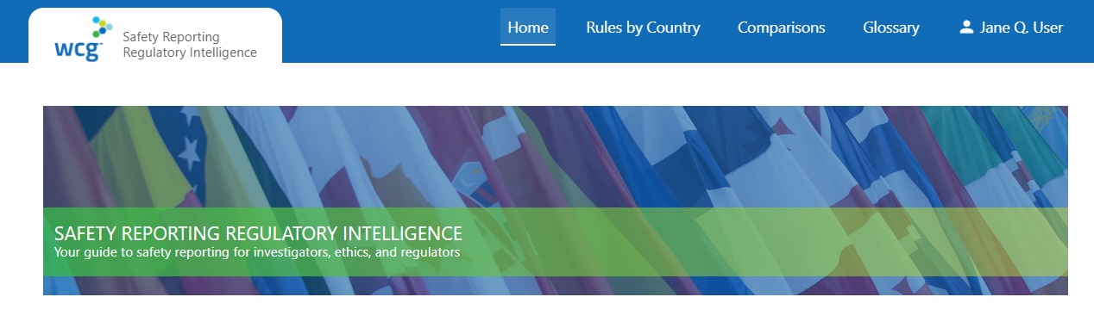

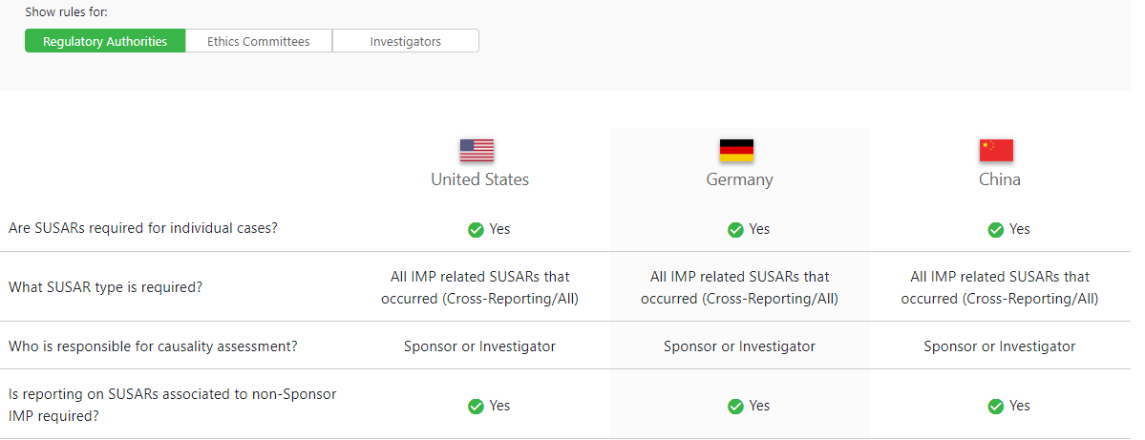
What is Safety Reporting Regulatory Intelligence (SRRI)?
Information as a service - Made available in a portal managed by WCG
The information available in SRRI is called the Safety Reference Model (SRM**)
Safety Reporting
Regulatory Intelligence
Notes:
For those who are not actively working on safety reference model, we also make it available in electronic form as our safety regulatory intelligence tool, a repository of laws, regulations, and rules for 125 countries enabling sponsors to know, not guess, the safety reporting requirements of investigators, ethics committees, and health authorities in every country in which clinical research is conducted.
This info is kept up to date with monthly change controls voted on by the quality consortium leadership advisory board, which removes a burden from sponsors to keep up with regulations or trust in their CROs, who may not be expert in particular countries, requiring a sponsor to employ multiple CROs with different safety databases.
Much as we love the large CROs and they have been some of the principal driving forces behind the safety reference model effort, we see gaps in how they support small and emerging companies. One frustrated drug safety manager from a small company said to me, we don’t get the A team. We don’t get the C team. We don’t even see a team – just a pool of different resources processing our reports without expertise in therapeutic area or country regulations.

Slide 10
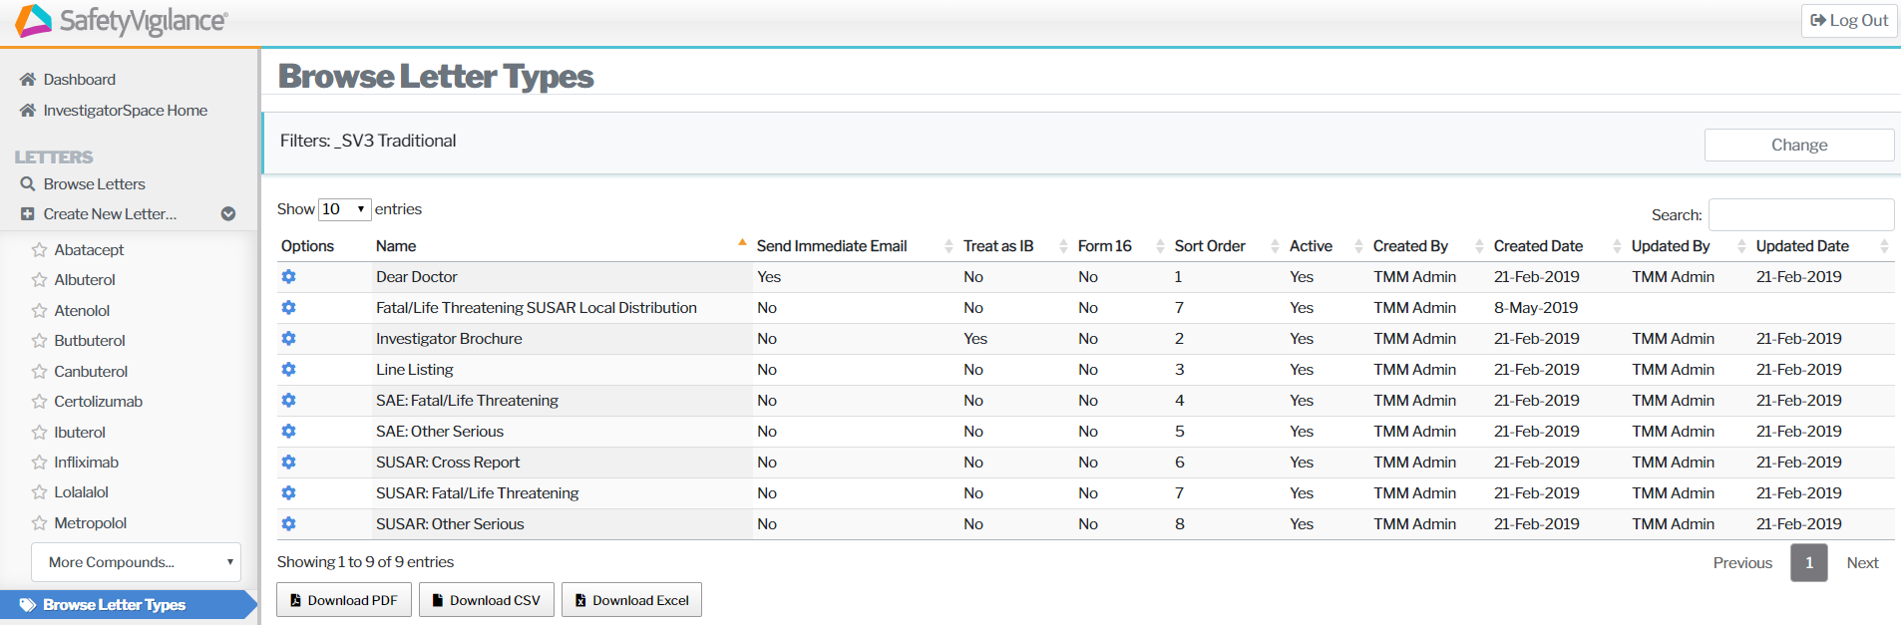
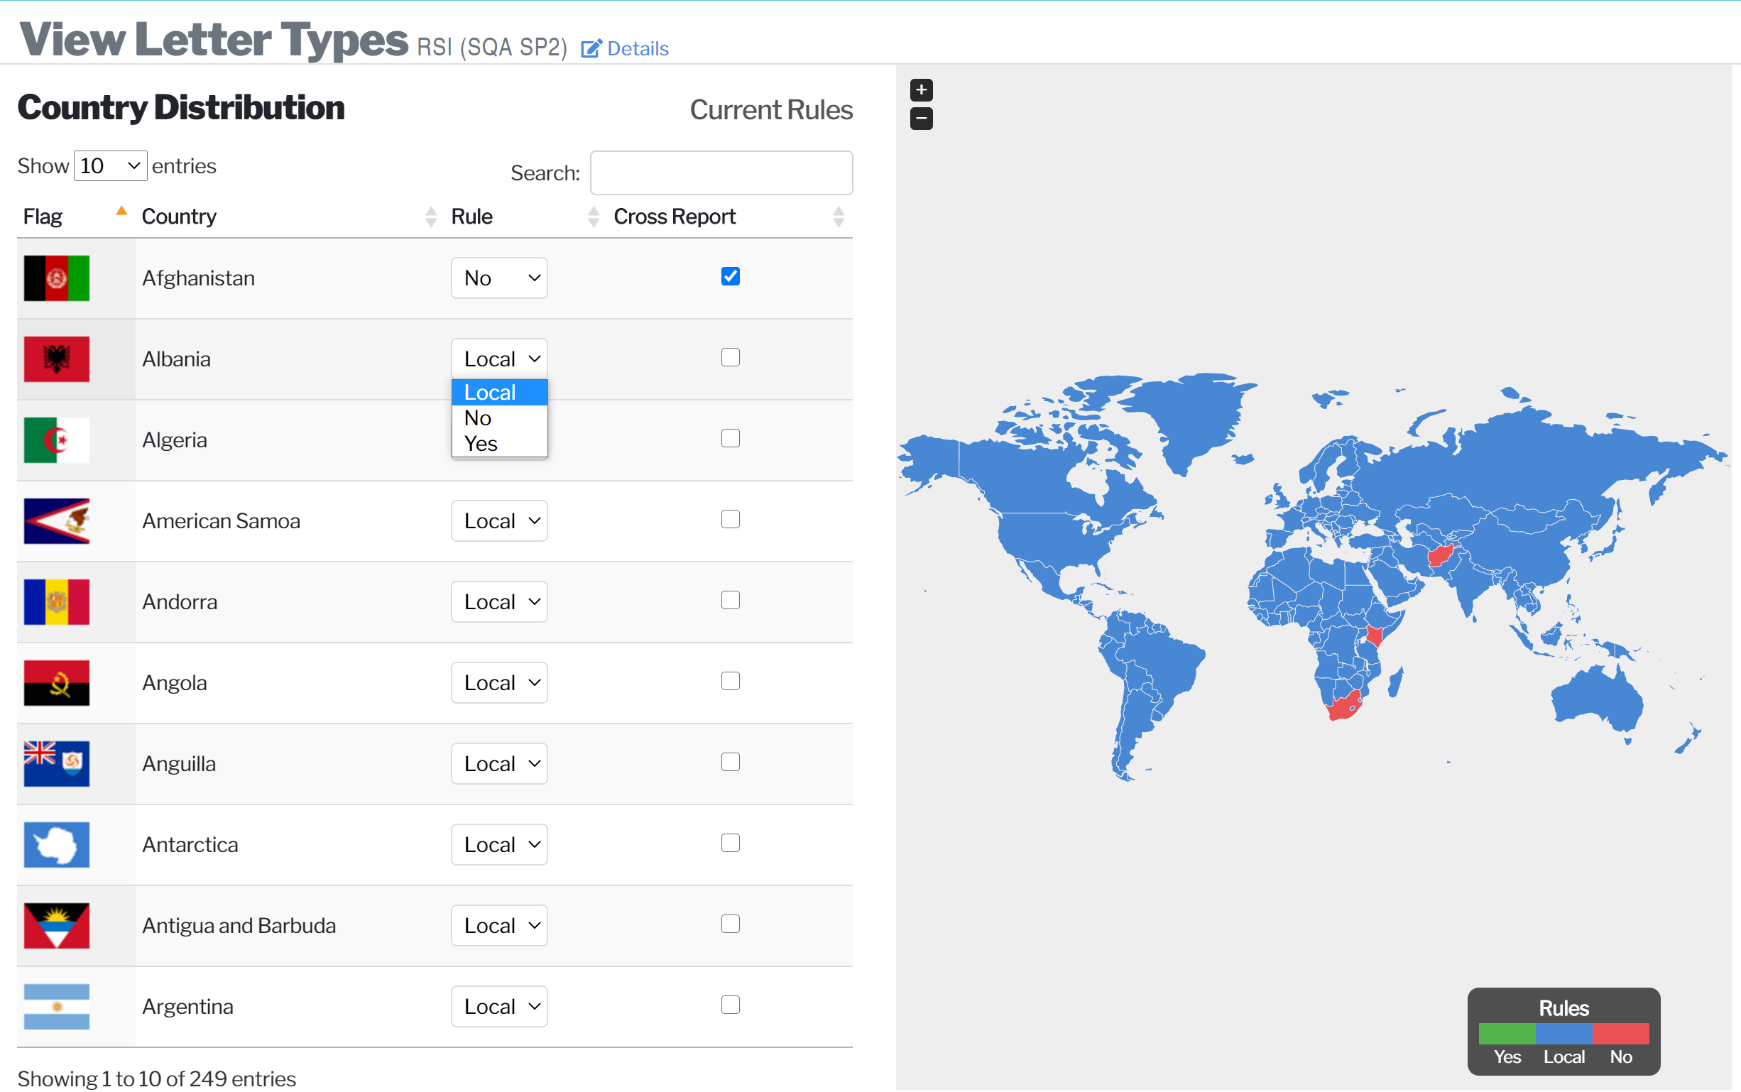
Global Safety Reporting Rules
1
2
Create Letter Types
Apply Country Level Rules
Notes:
We then apply this regulatory intelligence to our global safety reporting solutions that deliver over 100 million safety reports per year. This gives small and emerging companies access to the same technology that cost the leading pharma companies 10s of millions of dollars to create and enable precision distribution according to best practice interpretation of local laws.
It is critical to site experience to reduce the burden on investigators, particularly in oncology. Large site networks receive up to 20k safety reports per year. Sites don’t want to work with sponsors who over-report because they don’t have precision tools.

Slide 11
Global Safety Reporting Solution Overview
Precision Safety Report Distribution to Sites/ECs/Non-Gateway HAs
Safety Reference Model – automated distribution rules for 125 countries powered by regulatory intelligence
Comprehensive Out-of-the-Box Reports: PI and Site level receipt, transmission failure and acknowledgement reports
Blinded & un-blinded distribution
Perpetual Inspection Readiness: Extensive Archive & Reporting Capabilities
Notes:
Other advantages of fully automating drug safety submissions to sites, ethics committees and gateway health authorities include elimination of the cost and quality issues of doing this manually, minimization of burden on site and CRAs by automatically recording delivery and acknowledgement of safety report with a single click, secure blinded and unblinded distribution and perpetual digital inspection readiness, which regulatory agencies have come to increasingly expect during COVID.

Slide 12
Independent Expert Committees
Data Monitoring Committees
Monitors patient safety and/or treatment efficacy data during an ongoing clinical study.
Safety Assessment Committees
Review accumulating safety data to determine when to recommend the sponsor submit and IND safety report to the FDA and all participating investigators
Endpoint Adjudication Committees
Reviews clinical trial data in order to give expert opinions about clinical safety or efficacy events of interest.
Activities Required in Trial Oversight
Traditional Data Monitoring
Prescribed interim assessments of treatment efficacy
Application of prescribed futility boundaries
Safety Assessment
Unblinded data - Blinded data
Categorization of individual safety events
Integrated evaluation of trial safety data
Program-wide evaluation of safety data
Trial Progress, Conduct, and Quality
Evaluation of trial progress
Evaluation of quality of trial implementation
Evaluation of data quality
Adjudication of Study Endpoints
WCG maintains its own network, a “Virtual Faculty”, of over 900 expert physicians and statisticians that can serve as a source of committee members.
Notes:
The final advantage WCG offers are access to independent expert committees – data monitoring, safety assessment and endpoint adjudication. These are led by Janet Wittes and Jon Seltzer, 2 of the foremost experts on statistics and committees. We supply expert statisticians to run aggregate analyses on your compounds looking for safety signals that show greater frequencies or severities of adverse reactions than expected in your drug or the control group or the background population and expert physicians with specialized safety skills in your therapeutic area.
I’ll close with words from Bob Temple, the FDA deputy director, who spoke earlier this summer on over- reporting with Jacqueline Corrigan Curay and myself. You can still find this webinar online.
“This is your responsibility. Do your job and if you can’t do it yourselves, find someone who can.”

Slide 13
Q&A
Notes:
Q&A:
A few questions came in during the presentations, and we’ll start to address some of them now. The first question is:
How do you perform safety reporting in a country where you don’t have a local presence?
How do you scale up your safety operations?
I think that’s all we have time for today. If we didn’t get to answer your question during the webinar today, we will follow up with you after. Thank you to Angela for joining us today, and for sharing your expertise with us.
And thank you to the audience for joining us. If you want to listen to this broadcast again, you can continue to use the link you were initially provided, and an archived version will be up soon and provided to you.
Thank you all, and have a good day, and we hope you’ll join us again for our next webinar.

Slide 14
Thank you!

